Slide 1
CSC 4370 Project 3 Presentation
Ulysses Carlos

Slide 2
Project Roles
Ulysses Carlos
Main Programmer and Designer

Slide 3
The Problem
Create a Sliding Puzzle using JavaScript (Including DOM), HTML and CSS
Use at least one image
Clicking on a tile bordering the empty tile will move the tile to that position
Clicking on the blank tile/surrounded tile will produce no effect

Slide 4
Solution
Used HTML, CSS, and Javascript to finish the project
HTML
The Webpage itself
CSS
Controlled Page Background and table
JavaScript
Displayed Puzzle pieces
Implementated Puzzle Randomization, Solve For Me!, and Difficulty Level

Slide 5
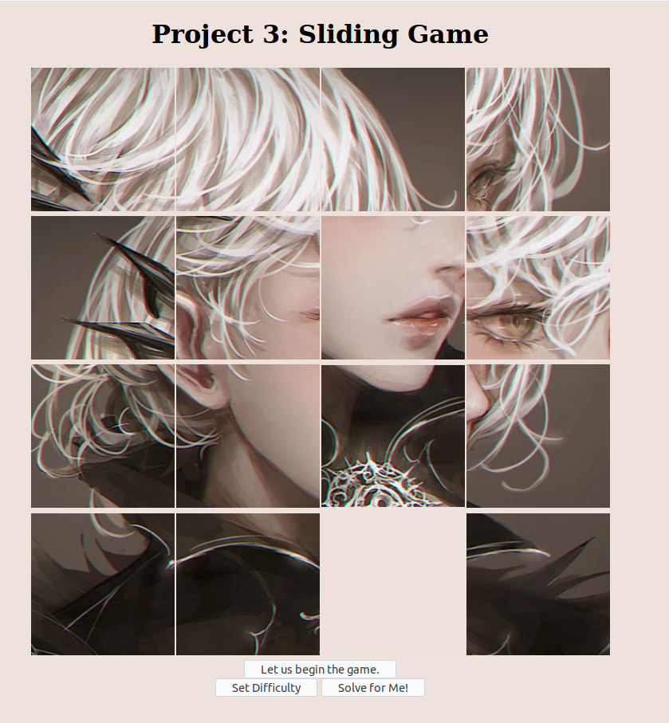
The Website
"Let us begin the Game" executes main() in main.js
Difficulty level can be changed by pressing the "Set Difficulty" button
The "Solve for Me!" Button will solve the puzzle regardless if you have started the puzzle or not.

Slide 6
The Website (cont)
An inline script plays a song throught the puzzle. It does not loop and is randomly choosen on each refresh.
The image displayed for each puzzle is chosen at random out of a collection of 10 different images.

Slide 7
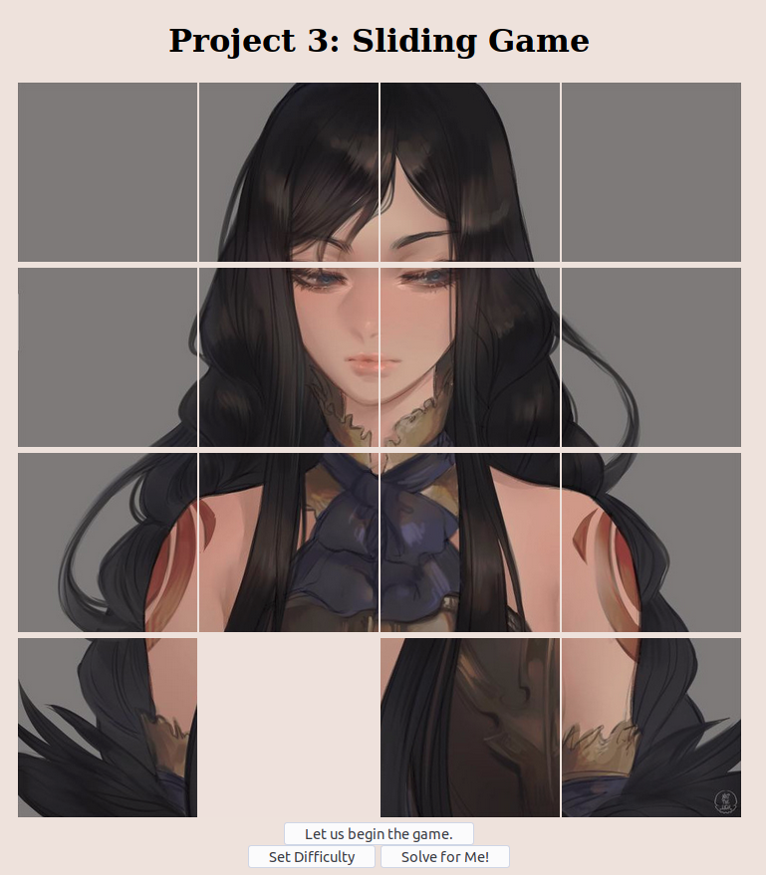
The Website(cont)
Each image has been broken down into 16 250x 250 tiles, which can be downscaled to any resolution.

Slide 8
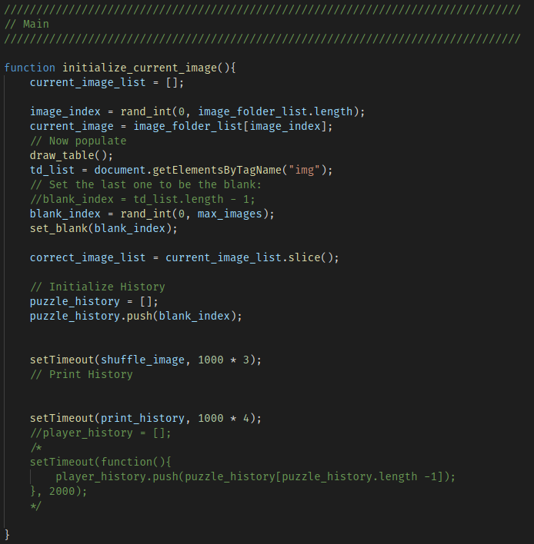
Main()
Pressing "Let us start the game" will call the function initalize_current_image() which sets the image tiles, randomizes it, initializes the puzzle history, and stores the solved image in an array.

Slide 9
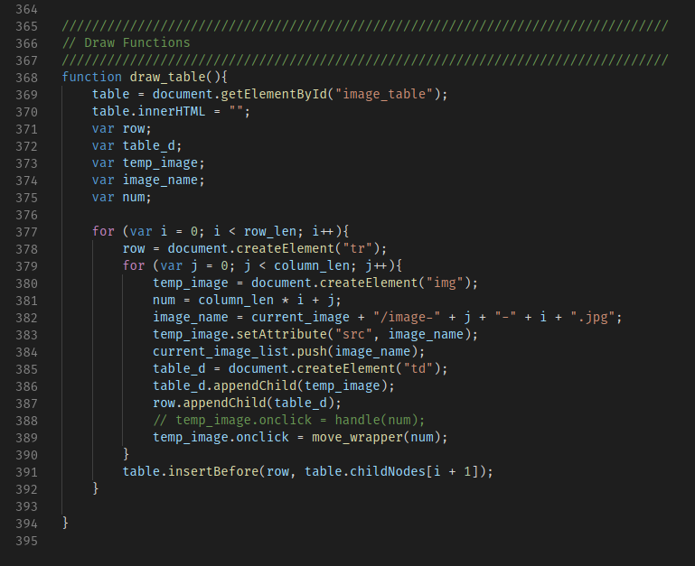
Draw_table()
An image is selected at random, and each segment is pushed into current_image_list
Each image has an onclick event move() which passes a value alongside it.
The image is stored in a table datum, which is appended into a row.
This row is then appended to the table.

Slide 10
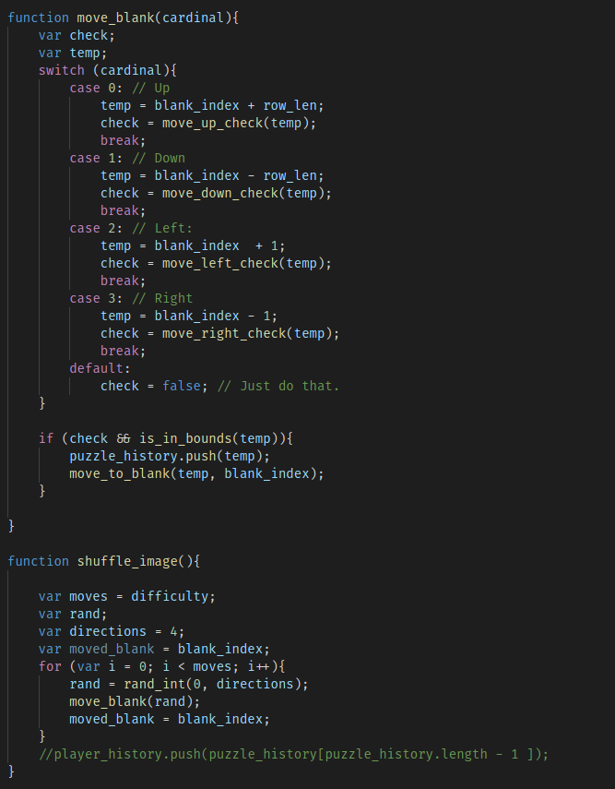
Shuffle()
From the blank tile, shuffle() shuffles the tiles based on difficulty.
The program randomly moves a direction and then determines if the move is valid.
If the move is valid, it adds a value to puzzle_history and swaps the two tiles.

Slide 11
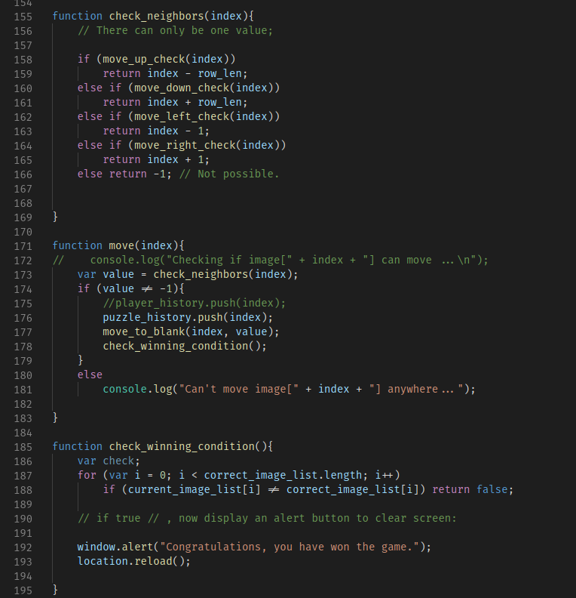
Move()
Accepts the parameter index, which is generated for each tile.
It determines if the tile can move by checking if any of its neighbors is a blank tile through the function check_neighbors
If a neighbor is a blank tile, it swaps both tiles, giving the impression that the tile has moved.

Slide 12
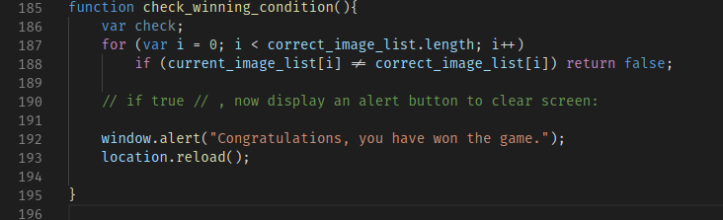
Move() (cont.)
check_winning_condition() is executed at the end of move() to determine if the puzzle has been solved.
The array correct_image_list is then compared to the current_image_list.
The game is won if both arrays are equal.

Slide 13
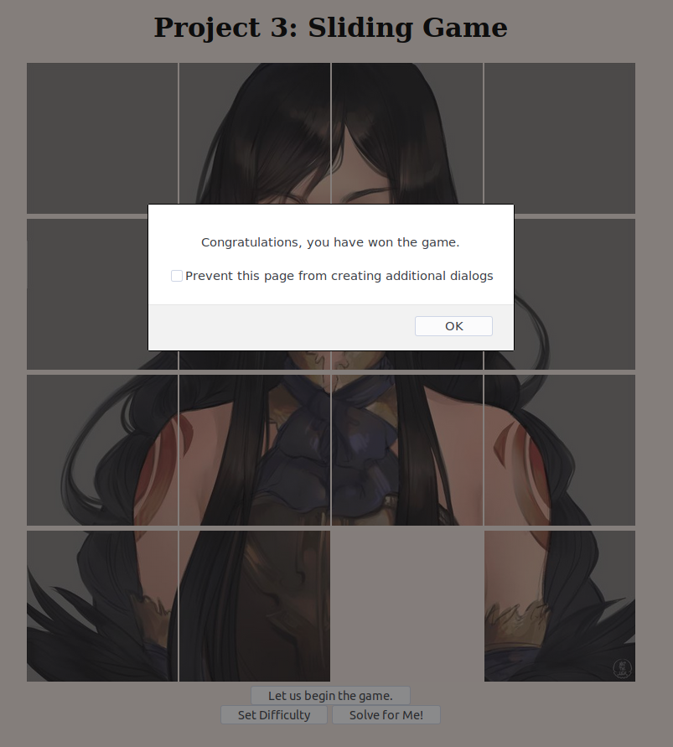
Move() (cont.)
A popup is displayed when the game is solved
Closing the popup will reload the page.

Slide 14
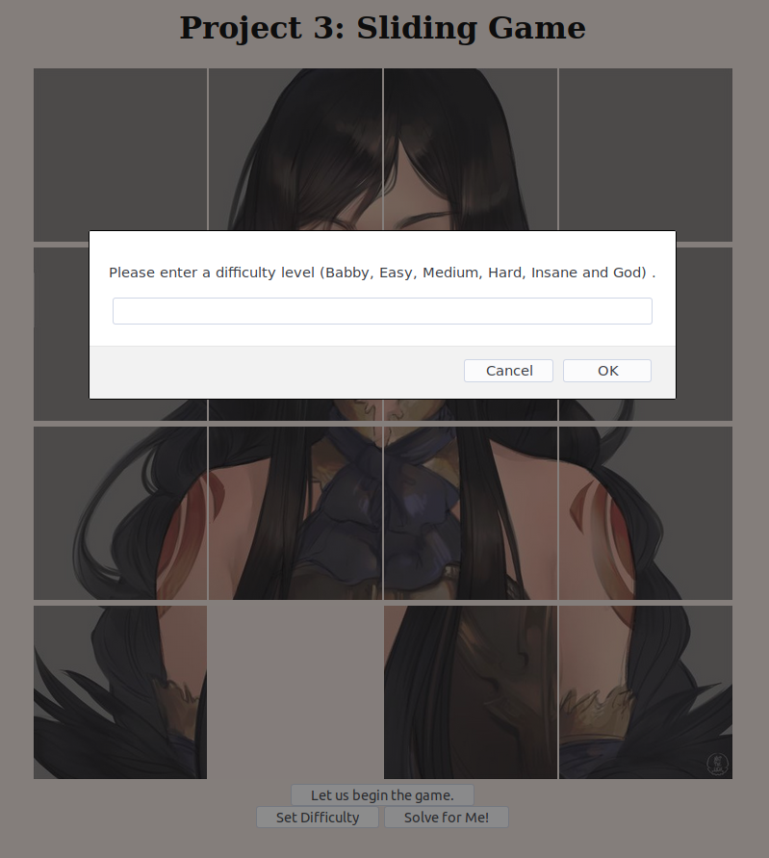
Difficulty
Clicking on "Set Difficulty" will open a popup that can change the difficulty level
The difficulty level will change the amount of moves that the program can use to randomize the image.

Slide 15
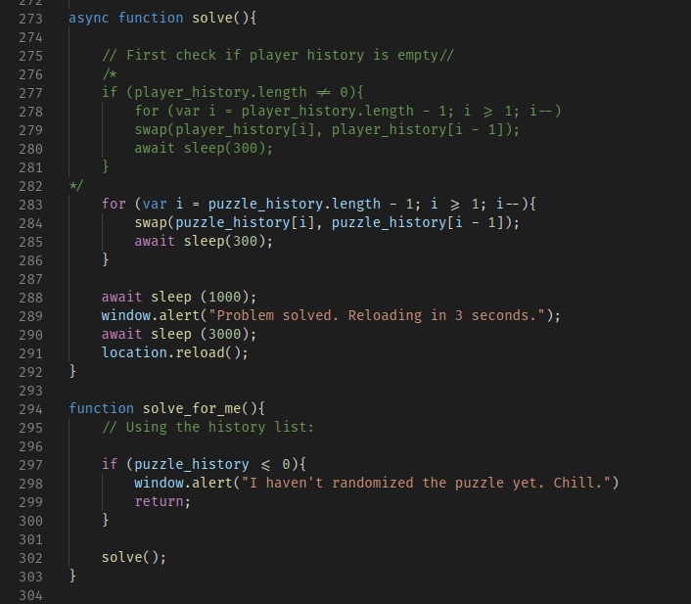
Solve_for_me()
Clicking on "Solve For Me" will solve the puzzle regardless if the player has moved tiles or not.
It activates solve_for_me(), which uses the array puzzle_history to backtrace back into the default image.

